Slide 1
PSFAChat
PSFAChat is an integrated feature of your PSFAConnect Portal.
Chat features allow staff to:
Connect with each other in a real-time conversational style
Catalogue conversations for later research
Build knowledge resources
PSFAChat may be downloaded to tablets, phones and computers.
*Chat conversations reside on PSFA servers, not on devices; therefore, you may also install on your personal devices.

Slide 2
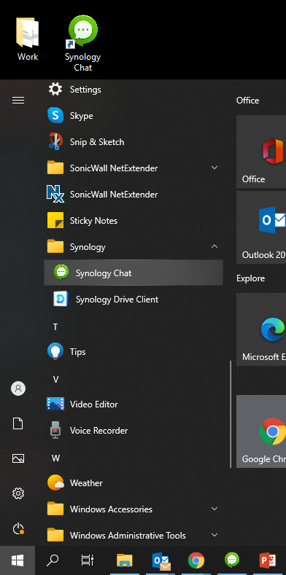
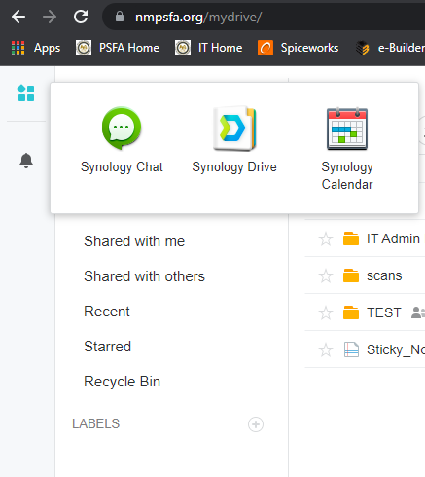
Where to find PSFAChat
Four ways to open PSFAChat
Open from your desktop.
Open from taskbar
Open from Start menu
Open from PSFAConnect
More detailed instructions can be found in the How-To’s section of the ISTD webpage at: https://istd.nmpsfa.org/how-tos

Slide 3
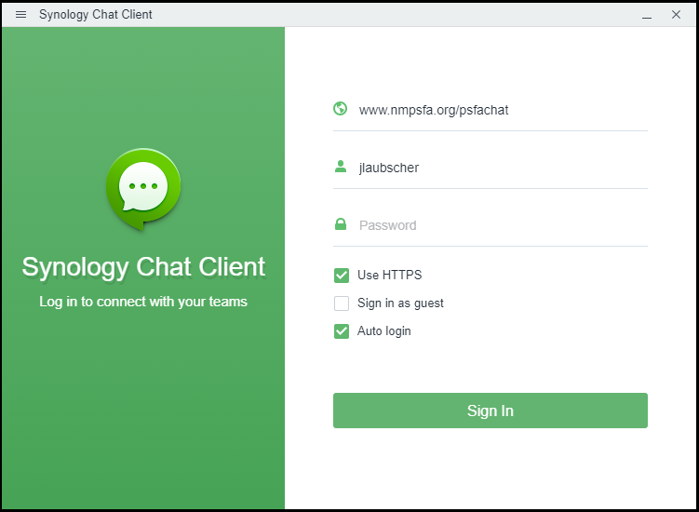
Logging In
Look for Chat Icon on the task bar
Use your computer username and password
The log in screen should look like the image to the right. Select check boxes and type the domain as shown
Click sign in
You should only need to perform this step once as long as “Auto login” remains selected.

Slide 4
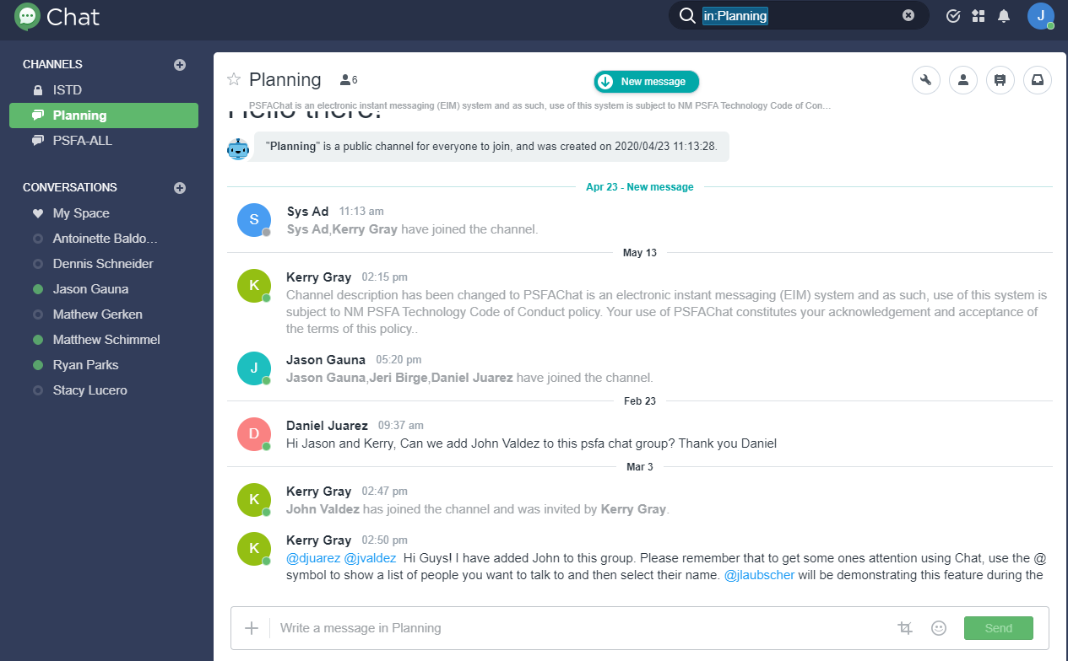
Main Features
3 Expand the plus sign to the right of Channels and Conversations sections to see more options.
2 To get the attention of a specific person, type the “@” symbol in the box followed by the first letter of their first name. A list will appear – just click on the name.
Be sure to click SEND when finished typing your message
Use “#” followed by a keyword to tag your comment; this allows for indexing and easy searching.
1 Write your message in the text box at the bottom of the screen then SEND.

Slide 5
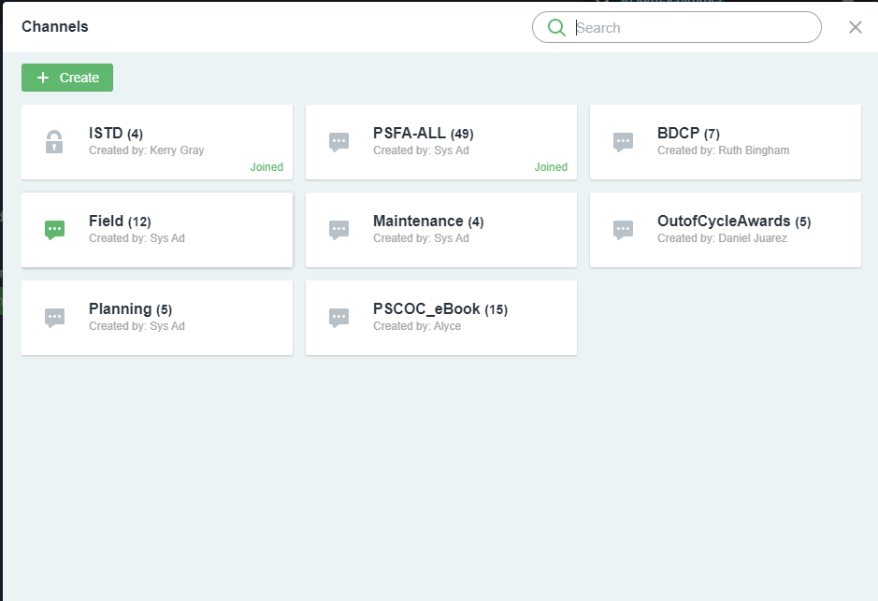
Joining Channels
When you click on the “Plus” icon across from Channels, you will be shown the window to the right.
If there is a lock symbol shown, submit a help desk ticket to join the Channel; otherwise, the Channel will be joined immediately upon selection.
Each one of tiles represents a Channel you may join.

Slide 6
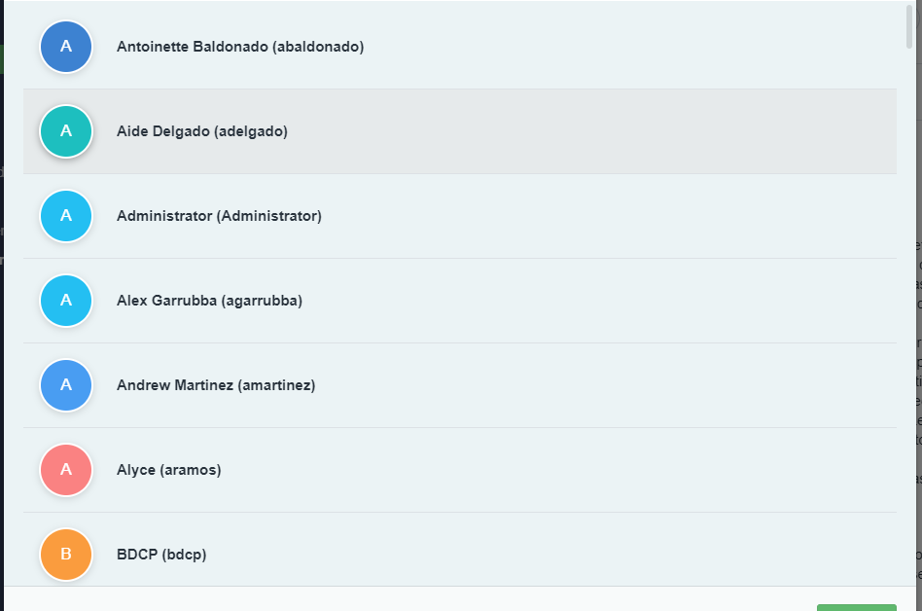
Conversations
“Conversations” allow you to carry on a one-on-one discussion with someone else, rather than with the entire Channel.
As with Channels, when selecting the “plus” icon, you will be shown a new window like that on the right.
This window allows you to search through PSFA staff. Once you have selected them you can chat one on one.
You are able to select multiple people as well; however, if you use this feature regularly, you may want to consider creating a new channel instead.

Slide 7
PSFA Outlook Calendaring
Simplifying Calendaring with Outlook
One app with all the information
More information when needed
Works with resources

Slide 8
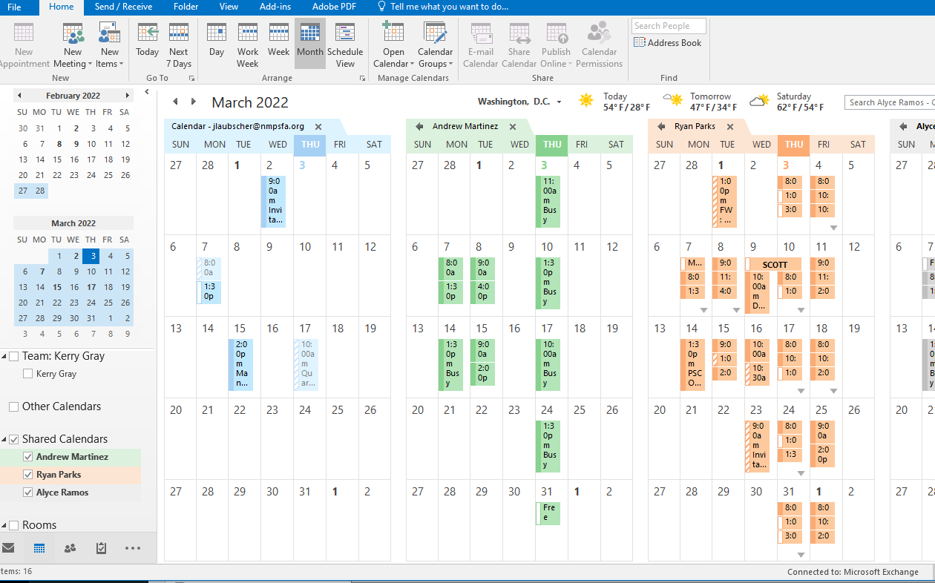
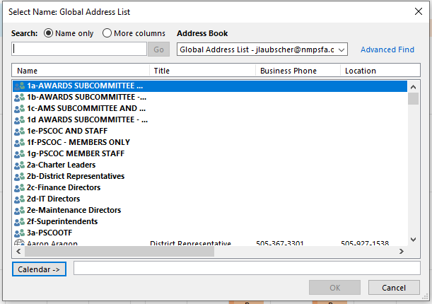
Opening Calendars
Using the Calendar Icon, navigate to Outlooks Calendar user interface.
Using the open calendar feature we are able to see other calendars in addition to our own.
The open calendar button at the top of the page will allow you to search by name.

Slide 9
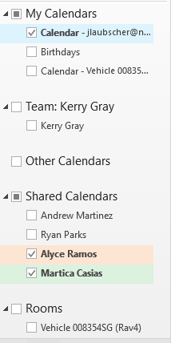
Changing viewed calendars
When you do not want to see the calendar uncheck the box on the left side.
To remove a calendar right click and select Delete calendar.

Slide 10
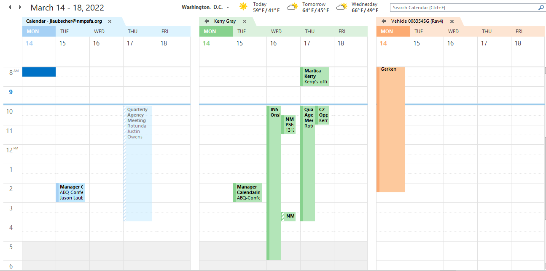
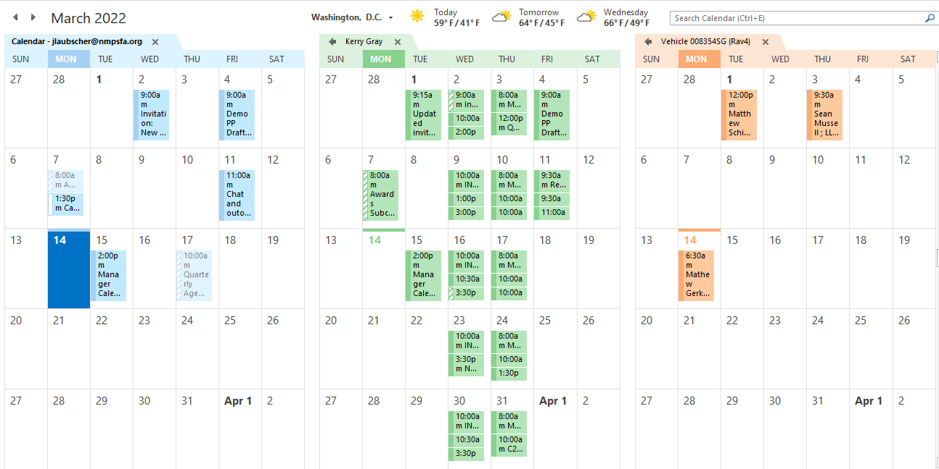
Changing calendar views.
Once calendars have been selected, the highlighted section can be used to change how far you see.
Simply select the view you prefer, day workweek, or month.
Examples to the right.

Slide 11
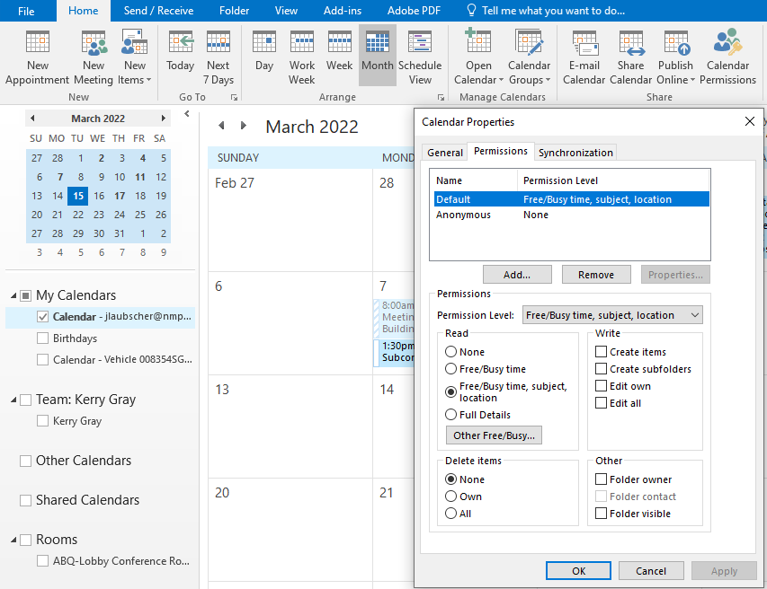
Calendar View Options
From Calendar View, select Calendar Permissions from the Ribbon bar.
Under the READ section select either “None”, “Free/Busy time”, “Free/Busy time, subject, location”, etc.
Click OK, or Apply then OK

Slide 12
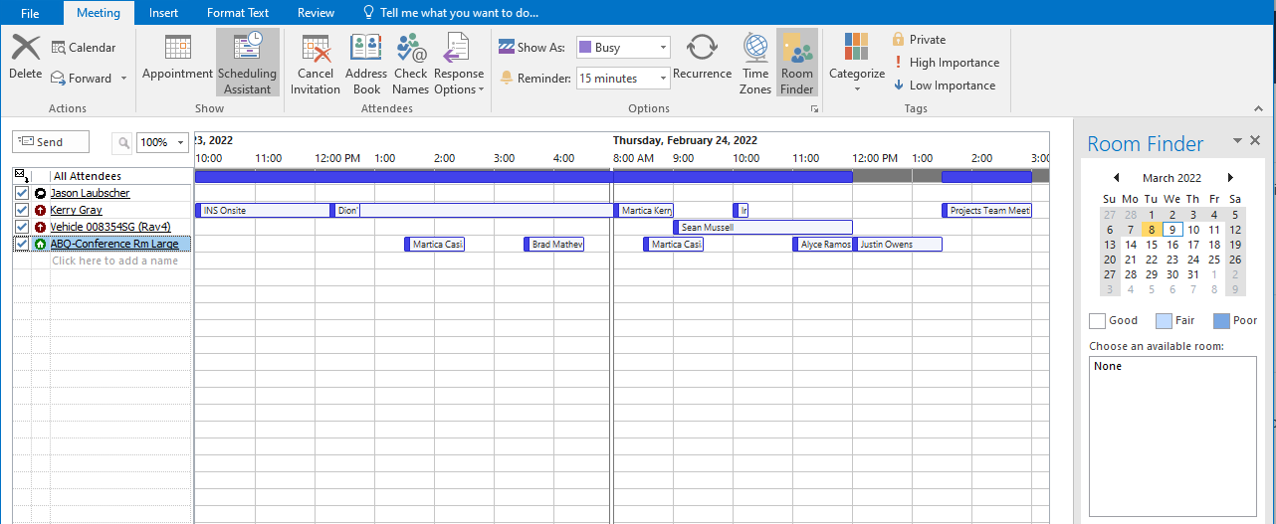
Scheduling assistant
With this tool you are able to see the calendars for all participants and avoid scheduling conflicts.
Use the Address book at the top or type their name in the field “click here to add name”.

Slide 13
Division heads should set expectations regarding departmental use of PSFAChat and Calendaring requirements
PSFAChat Code of Conduct may be reviewed here: https://istd.nmpsfa.org/technology-code-conduct

